Slide 1

Welcome to
The Daniel Plan
Intro session

Slide 2

Happy New Year 2015
Any New Year’s Resolutions?
Do you want to get healthier?
  Diabetes
  High Blood Pressure
  Arthritis/Chronic Inflammation
  Chronic Fatigue Syndrome
  Headaches (Tension, Migraines, Cluster)
  Allergies/Chronic Sinusitis
  Irritable Bowels

Slide 3

Developed and written by:
  Pastor Rick Warren Minister, Founder of Saddleback Church, Author of “The Purpose Driven Life”
  Dr. Daniel Amen Physician, double board certified psychiatrist, teacher and author. Founder of the Amen Clinics.
  Dr. Mark Hyman Family Physician, author, speaker, educator and advocate in the field of Functional Medicine. Founder of the UltraWellness Center.
In conjunction with the Daniel Plan Team: Dee Eastman Director, Sean Foy & Jimmy Pena Exercise Physiologists, Steve Willis & April O’Neil.

Slide 4

It’s a Lifestyle change!
Diet

Slide 5

Introduction by
Pastor Rick Warren
2:00

Slide 6


Slide 7
The Daniel Plan Essentials
Faith
Food
Fitness
Focus
Friends

Slide 8

FAITH
“I can do all things through Christ who strengthens me.”
Phillippians 4:13

Slide 9


Slide 10

FOOD
“So whether you eat or drink, or whatever you do,
do it all for the glory of God.”
1 Corinthians 10:31

Slide 11


Slide 12

FITNESS
“Do you not know that your bodies are temples of the Holy Spirit…
Therefore honor God with your bodies.”
1 Corinthians 6:19a, 20b

Slide 13


Slide 14

FOCUS
“Do not conform to the pattern of this world,
but be transformed by the renewing of your mind.”
Romans 12:2

Slide 15
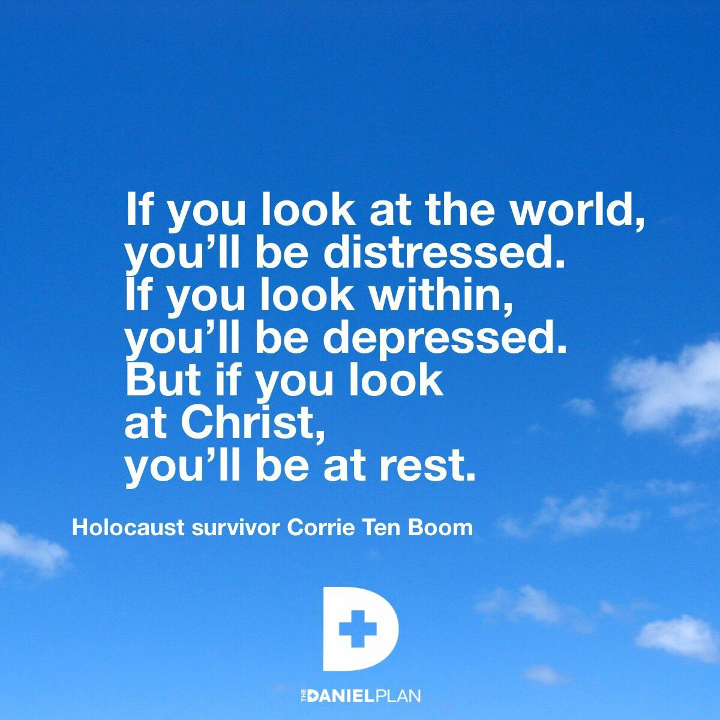

Slide 16

FRIENDS
“Two people are better off than one,
for they can help each other succeed.”
Ecclesiastes 4:9

Slide 17


Slide 18
The Daniel Plan Video Series
Each Sunday, we will watch a video session followed by group discussion.
Together we can offer each other support.
And each week we will have the opportunity to work on planning/preparing healthy foods. (Church Kitchen, Sunday afternoons ).

Slide 19
Sunday School Schedule
Each session will start promptly at 9:30am
The Daniel Plan Simulcast Sat, Jan 10 at 9am
Session 1 Faith Jan 11
Session 2 Food Jan 18
Session 3 Fitness Jan 25
Session 4 Focus Feb 1
Session 5 Friends Feb 8
Session 6 Living the Lifestyle Feb 15
Conclusion: Review & Results Feb 22

Slide 20
The Daniel Plan Resources
Books:
The Daniel Plan: 40 Days to a Healthier Life**
The Daniel Plan Study Guide & DVD series *
The Daniel Plan Journal
The Daniel Plan Cookbook: Healthy Cooking for Life

Slide 21
The Daniel Plan Resources
Online
www.danielplan.com Official website, please go online and register. It has tons of resources, including a weekly newsletter and connecting you to the Daniel Plan community. It will provide links for social media and much more.

Slide 22
Getting Started
Pray about it.
Make a commitment today. Tell someone!!!
Purchase the book- recommend 1 per household.
Start reading the book.
Prepare to eat healthier. A shopping list is included in the book. This will involve a significant cost for most of us to start with. However, the cost will decrease as you develop new eating habits.
Plan to come to Sunday School for the next 7wks.

Slide 23
And Finally…
Watch this video clip….
“The First Habit of Health: Food”
16:03

